Slide 1

Sudoku Solver using AI
Artificial Intelligence Meets Number Puzzle. Solving Complex Puzzles with Smart Algorithms. Presenter Name. Date.
Notes:
1

Slide 2
Understanding Sudoku
9x9 grid with 3x3 sub-boxes. Goal: Fill grid with digits 1-9. Each row, column, and 3x3 box must contain unique digits. Partially filled puzzle with one unique solution.
Notes:
2

Slide 3
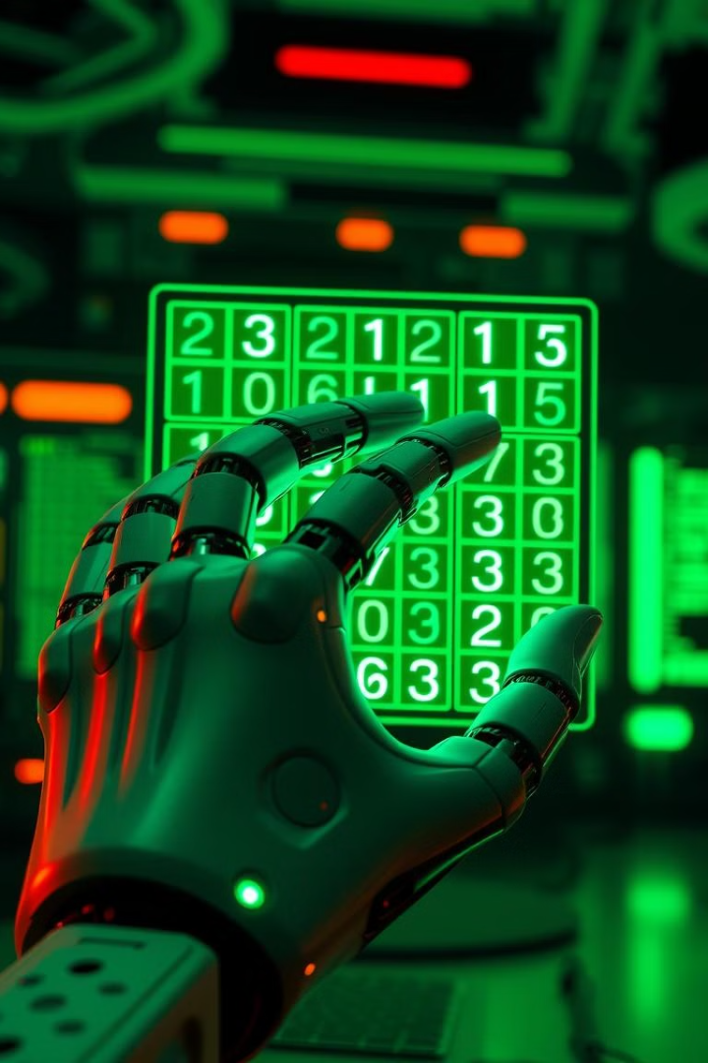
Project Objective
Develop an AI-powered Sudoku solver. Implement Backtracking Algorithm. Solve puzzles efficiently and accurately. Demonstrate computational problem-solving.
Notes:
3

Slide 4
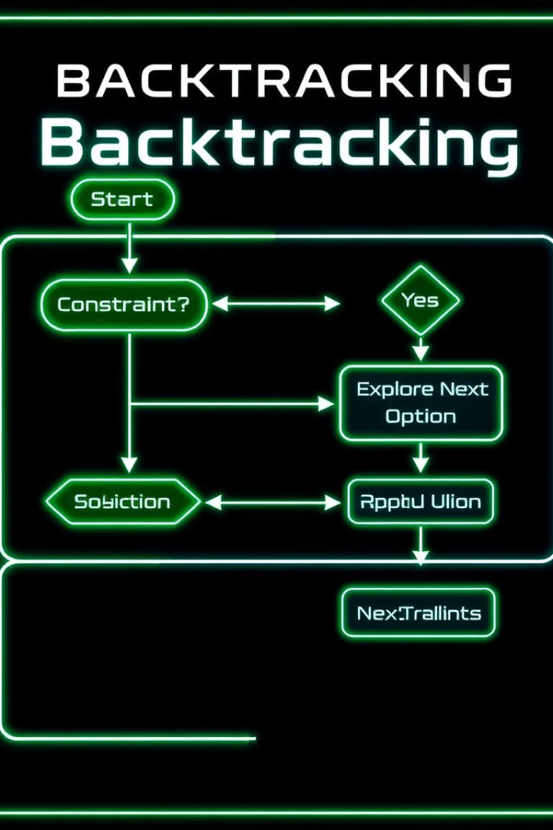
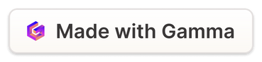
Methodology: Backtracking Approach
Recursive algorithm explores the solution space. Identify empty cell. Try digits 1-9. Validate placement rules. Backtrack if the solution is impossible.
Notes:
4

Slide 5
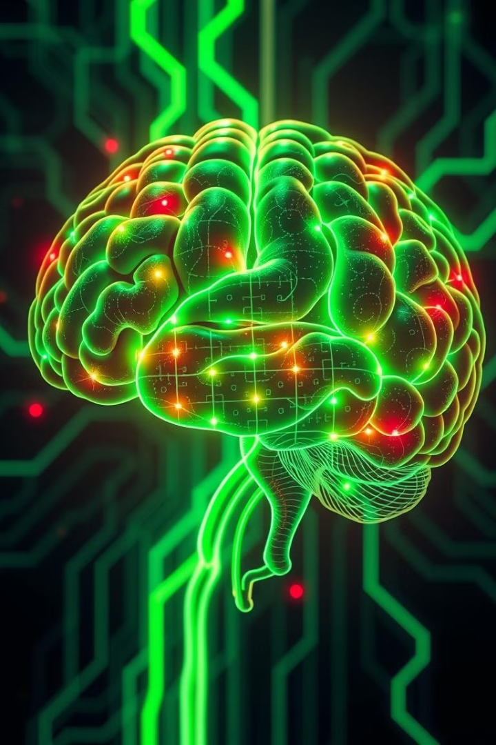
AI Problem-Solving Technique
Intelligent trial and error method. Eliminates invalid paths quickly. Reduces computational complexity. Mimics human problem-solving strategy.
Notes:
5

Slide 6

Thank You
Notes:
6

